Slide 1
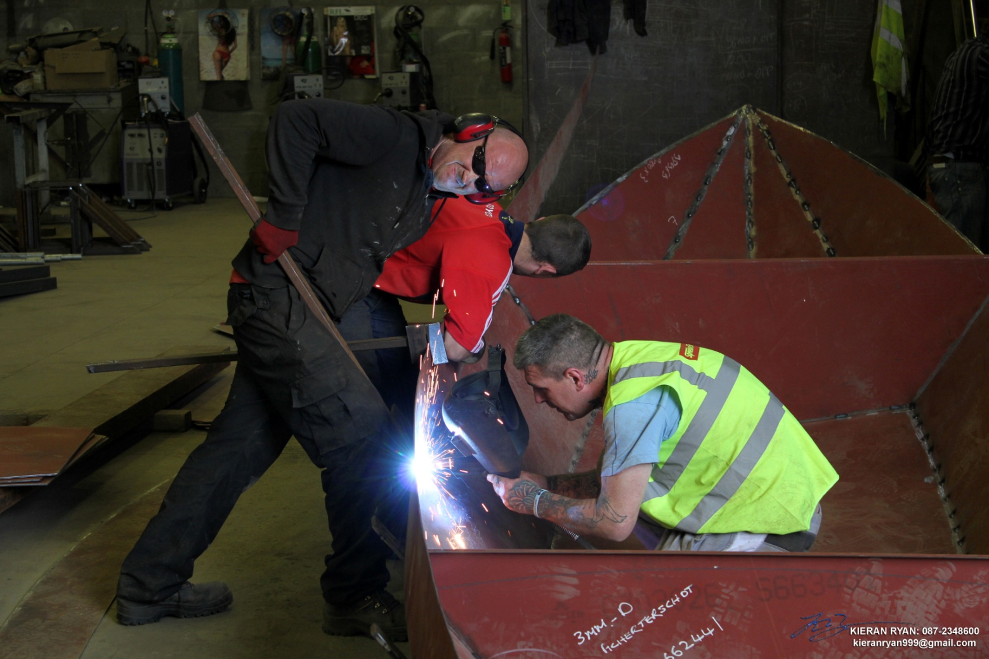
OPERATION LELIEVLET

Slide 2
LELIEVLET ON THE SHANNON IN LIMERICK CITY

Slide 3
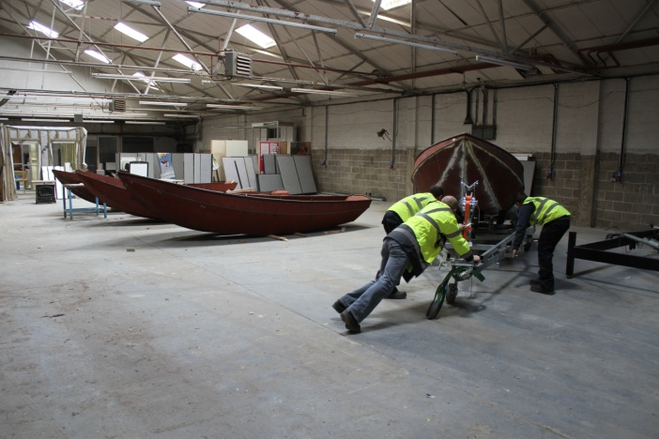
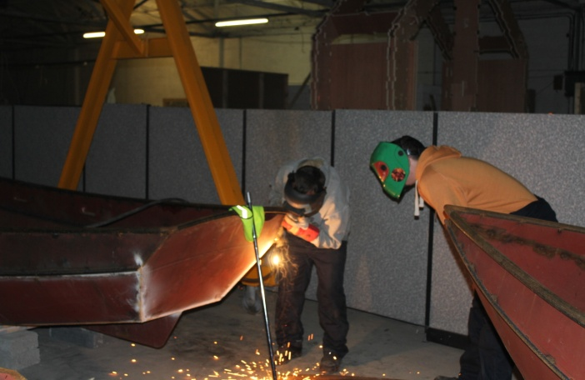
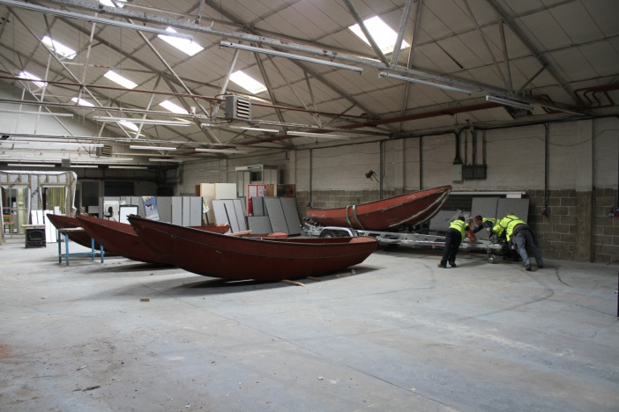
WORKSHOP IN LIMERICK

Slide 4
SCOUTING IRELAND
First Limerick built Lelievlet “John Brennan” on Lough Derg at Ballina/Killaloe for Camp 3

Slide 5
LINKING IN SCOUT VISIT TO WORKSHOP

Slide 6
SUPPORT

